Slide 1



Cosmic Frog Model Connections Using Alteryx
02/28/2025

Slide 2
Initial Setup

Slide 3
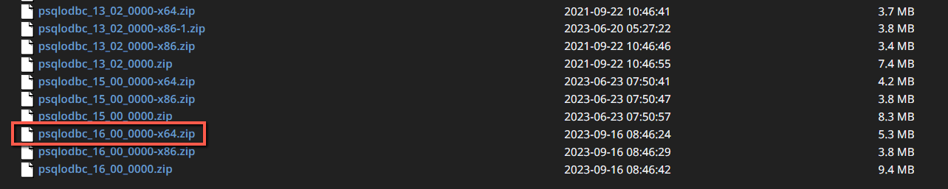
Postgres ODBC Installation
Many tools, including Alteryx, use Open Database Connectivity (ODBC) to enable a connection to the Cosmic Frog model database. To access the Cosmic Frog model, you will need to download and install the relevant ODBC drivers. Latest versions of the drivers are located here: https://www.postgresql.org/ftp/odbc/versions/msi/
The instructions below use the file: psqlodbc_16_00_0000-x64.zip and run the psqlodbc_x64.msi that are located on the bottom of the versions page.
When installing, use the default settings from the installation wizard.

Slide 4
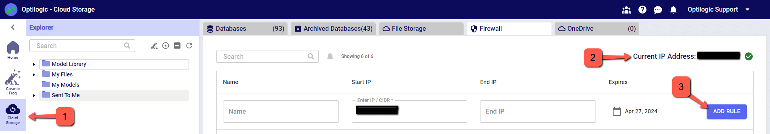
Enable Firewall Access
To make a local connections, you must first open a Firewall connection between your local IP address and your Cosmic Frog databases. This can be done in one click for all databases.
Go to the Cloud Storage section of Cosmic Frog. Click on the Firewall tab
Click ‘Add Rule’.
  Generally, you should only have to do this once per IP address. Moving to a different internet connection may require re-authorizing.

Slide 5
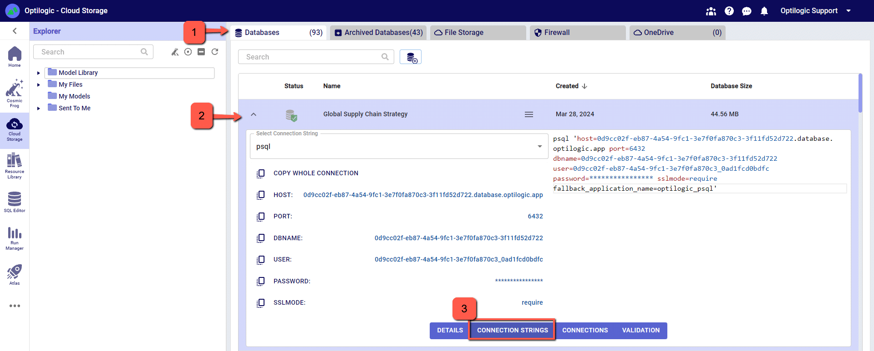
Connection Paths to your Database
Still in the Cloud Storage area, click on the model you wish to connect to. Selecting the “Connection Strings” button will show the connection information
The connection strings and paths required to make a connection to this database are located on this screen. Each database has a unique connection string.
For this example, we will copy and paste the strings for the ‘PSQL’ connection. The screen should look something like the following:

Slide 6
Setting Up a New Cosmic Frog Data Source

Slide 7
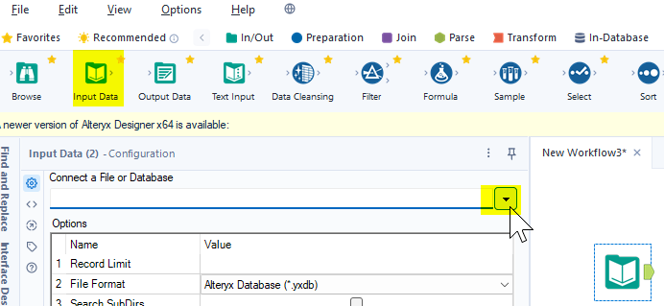
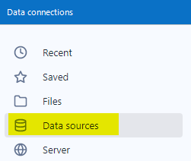

Setting Up a New Cosmic Frog Data Source
At this point we have the pieces to make a connection in Alteryx. We now want to create a new Data Source definition in Alteryx that connects to our Cosmic Frog model.
Open Alteryx and start a new Workflow. Drag the Input Data tool into the Workflow and click to “Connect a File or Database.”
  Output tools can be used as well.
Select “Data sources” and scroll down to select “PostgresSQL ODBC”

Slide 8
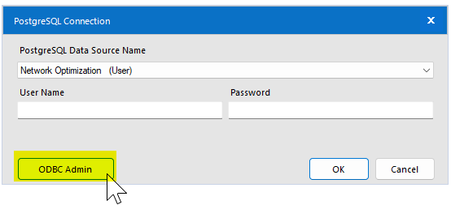
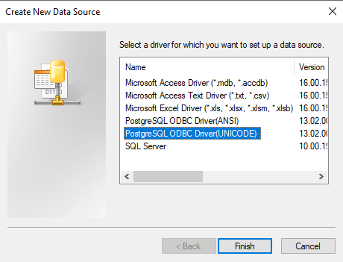
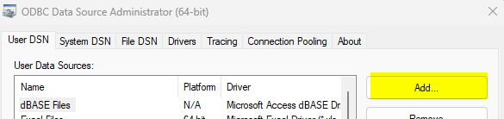
Setting Up a New Cosmic Frog Data Source
On the next screen click “ODBC Admin” to setup the connection.
Click “Add” to create a new connection and then select a “PostgreSQL Unicode” option. Then click “Finish.”
Depending on your Alteryx version and settings, you might see a different menu at this step. If you are using the Data Connection Manager, see the following slide

Slide 9
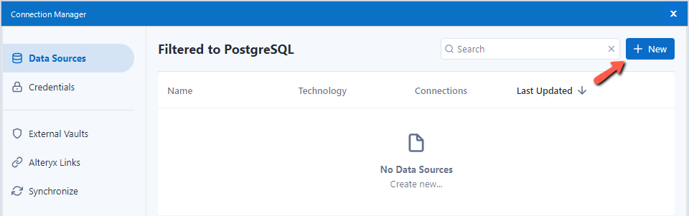
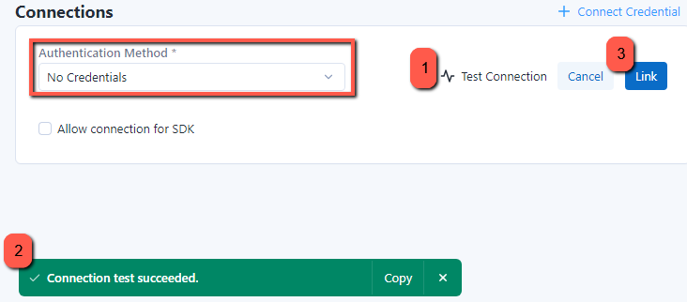
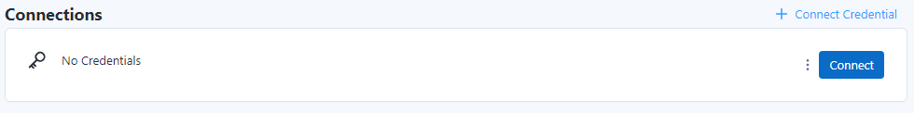
Data Connection Manager
From the Data Sources menu, create a new connection
Give a Data Source Name and configure the ODBC DSN connection, hit Save
  If you do not have an ODBC connection set up, click on the settings wheel. Detailed instructions for configuring an ODBC DSN can be found on slides 10-11
You’ll next be prompted to link Credentials, hit ‘+ Connect Credentials’
  The ODBC is already configured with this information – you can select No Credentials as the Authentication Method. Test Connection to make sure it is working, then hit Link.
Finally, hit Connect

Slide 10
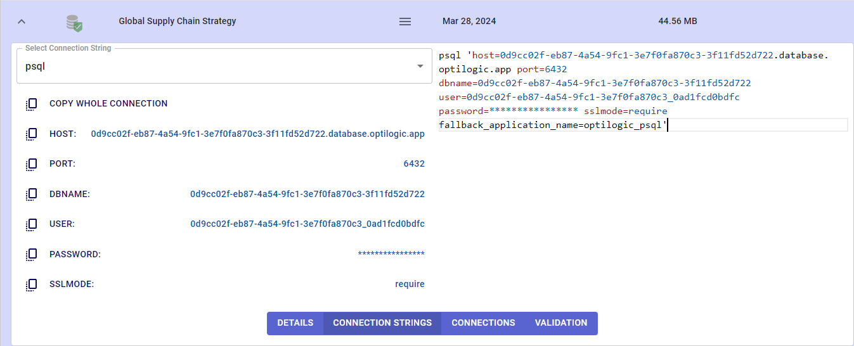
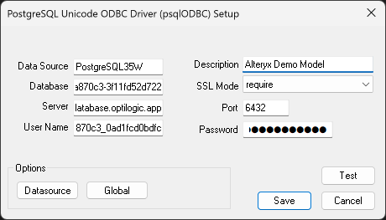
Setting Up a New Cosmic Frog Data Source
Now we need to configure the Data Source with the model’s connection string information found in the Cosmic Frog cloud storage section. See the ‘Connection Paths to your Database’ slide in the first section.
“Data Source” and “Description” allow you to name the connection.
  These can be named whatever you wish, but we recommend matching your name for the model is Cosmic Frog.
Copy the values for “Server”, “Database”, “User Name”, “Password” and “Port” directly from the Cosmic Frog.
DON’T FORGET to select “require” in “SSL Mode”.
You may click “Test” to confirm the connection works or click “Save.”

Slide 11
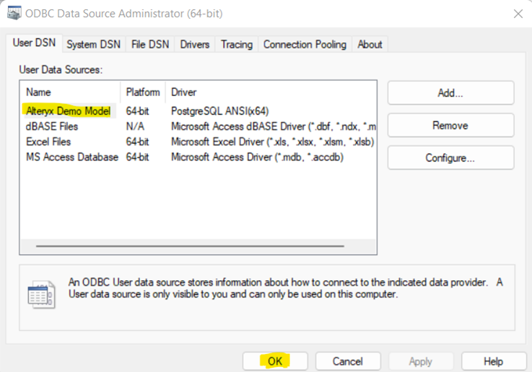
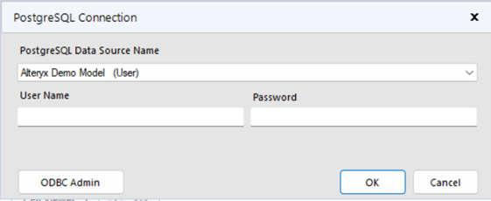
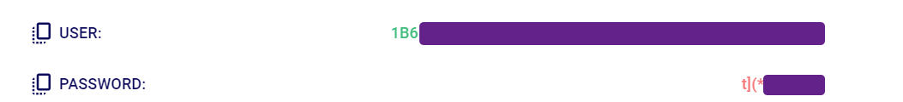
Setting Up a New Cosmic Frog Data Source
Now select the new connection, in this example “Alteryx Demo Model” and click “OK”
We need to select the same Data Source that we just built in ODBC within Alteryx. We need to enter the username and password for the connection for Alteryx authentication. These are the same credentials used to setup the ODBC connection. Remember to use your specific model’s credentials from the Connection String in the Optilogic platform Cloud Storage page.

Slide 12
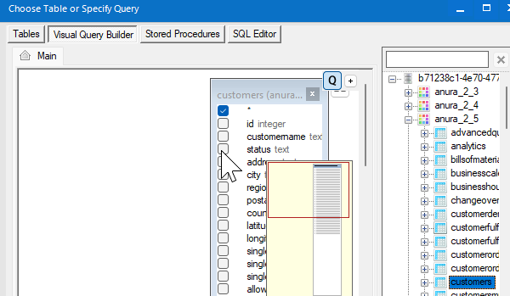
Setting Up a New Cosmic Frog Data Source
The input/output tool configuration can now be completed.
For input tools, a pop up allows you to build SQL queries for pulling data from the Cosmic Frog model. If using Visual Query Builder, be sure to drag and drop from the latest Anura schema’s drop down (currently v2.5).

Slide 13
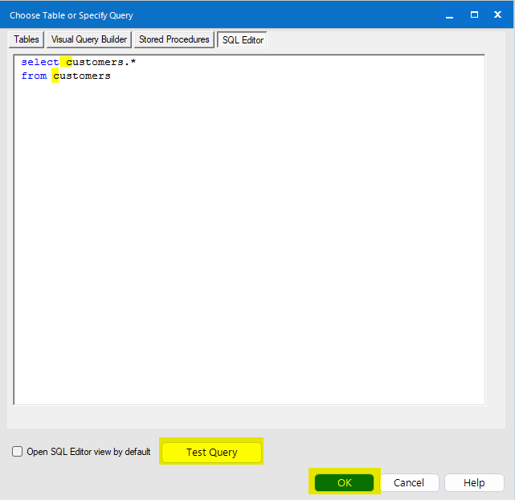
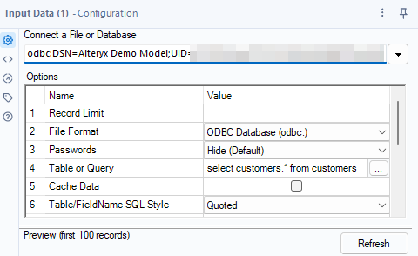
Setting Up a New Cosmic Frog Data Source
To complete input too setup, check that the SQL editor view does not list the Anura version prefix or database name for the tables. This will assure the query works after any Cosmic Frog version upgrades. It is good practice to use the ‘Test Query’ button.
Select ‘OK’. The configuration window should now look similar to this.

Slide 14

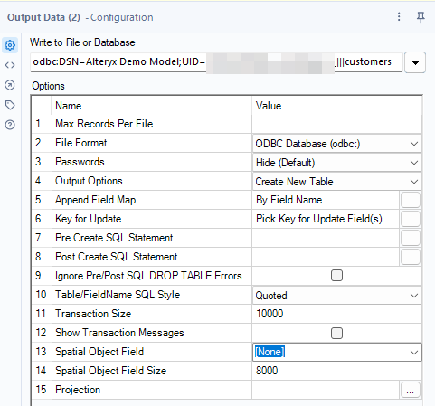
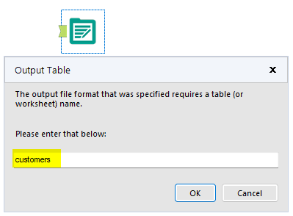
Setting Up a New Cosmic Frog Data Source
For output tools, a window that requires you to manually enter the name of the Cosmic Frog table that you are trying to write into will pop up. Enter the table name (lower-cased) in the indicated field.
Select “OK”. The configuration window should now look similar to this.

Slide 15
Creating Saved Connections

Slide 16
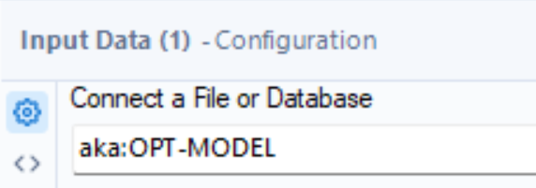
Creating Saved Connections
Saved Connections are recommended when managing several data pulls/pushes to Cosmic Frog models.
Saved Connections are created by assigning an existing Data Source.
  See the ‘Setting Up a New Cosmic Frog Data Source’ section.
Saved Connections require extra setup but are later easier to manage within the Alteryx tools. See example below of a Saved Connection in an input tool.
  Saved connections will always have the ‘aka:’ prefix in Alteryx tools.
Reusing Saved Connection names is handy when sharing workflows between multiple users or updating workflows to point to new models. See ‘Reuse A Saved Connection Name’ section.

Slide 17
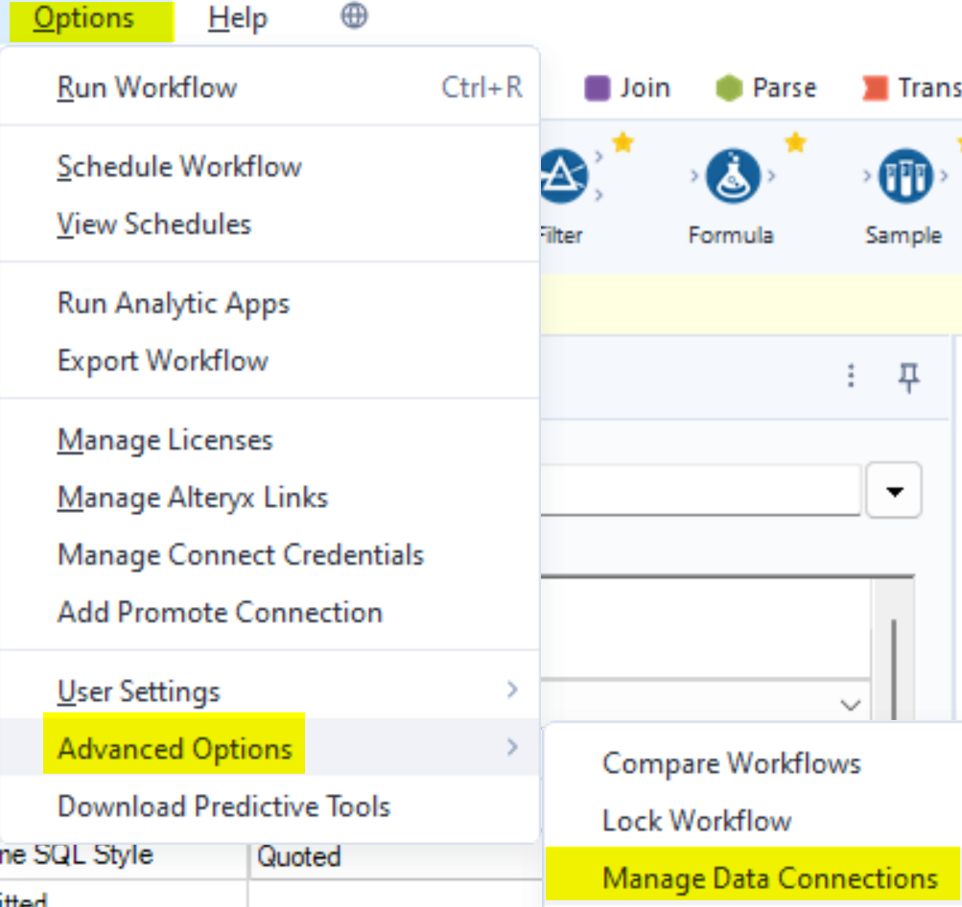
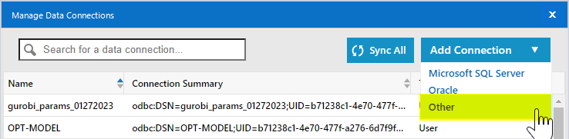
Creating Saved Connections
To create a new Saved Connection, navigate to the ‘Manage Data Connections’ screen. Click on “Other” in the “Add Connection” drop-down menu.
If you are not seeing the ‘Manage Data Connections’ option, please see next slide

Slide 18
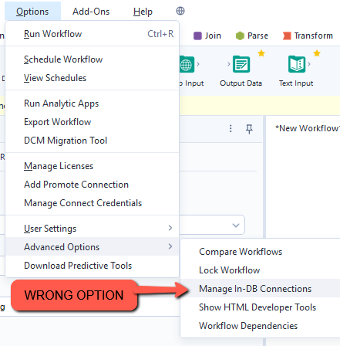
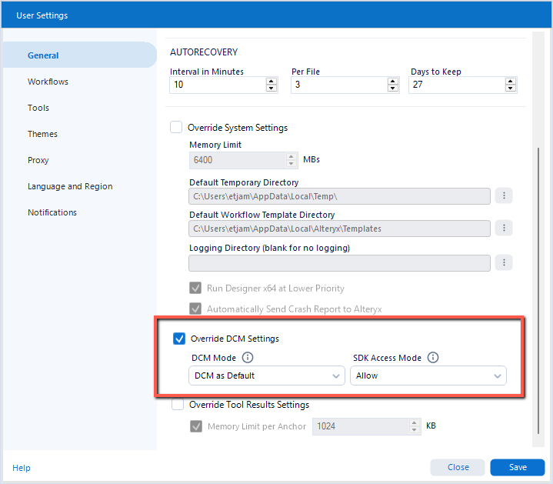
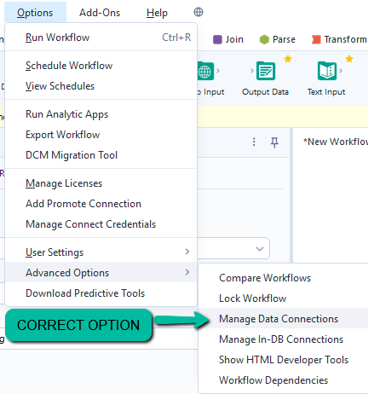
Creating Saved Connections
If you are missing the option for ‘Manage Data Connections’, you will need to adjust a User Setting in Alteryx
Under Options > User Settings > Edit User Settings > General, select the option to Override DCM Settings

Slide 19
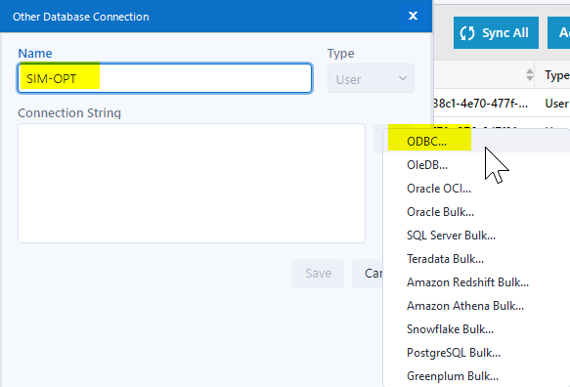
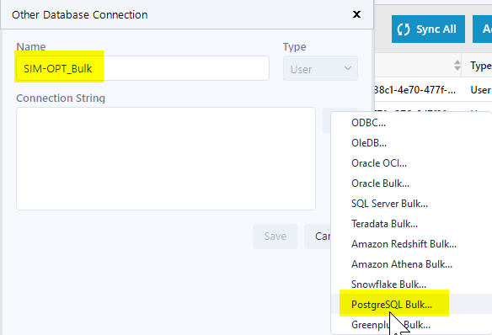
Creating Saved Connections
Name the new saved connection, select “User” from the “Type” drop-down and then click on the down arrow of the “Connection String” to select:
  “ODBC…” if setting up a connection to use with input tools
  “PostgreSQL Bulk….” if setting up a connection to use with output tools. This greatly reduces upload time.
  The same Data Source can be used with multiple saved connections.
  Recommendation is to indicate in the Saved Connection name which are type ‘Bulk’

Slide 20
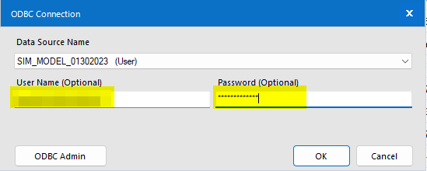
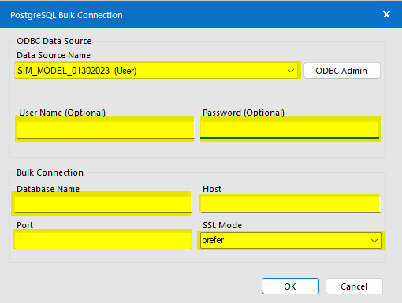
Creating Saved Connections
In the new pop up, in the “Data Source Name” drop-down, select a Data source of the newly created saved connection.
Fill out again all the highlighted fields and click “OK”.
  This is the same connection information required when setting up the Data Source. This can be copied from the Cosmic Frog Cloud Storage section.
  Additional information is required on this screen when configuring a Bulk connection.

Slide 21
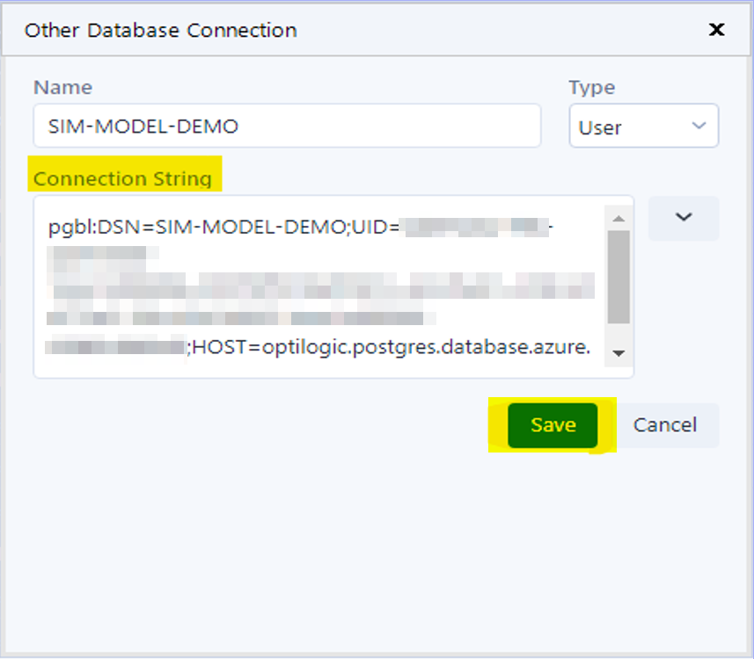
Creating Saved Connections
This leads to a populated connection string, after which you will need to click “Save”. Then click on the newly created connection and close the window.

Slide 22
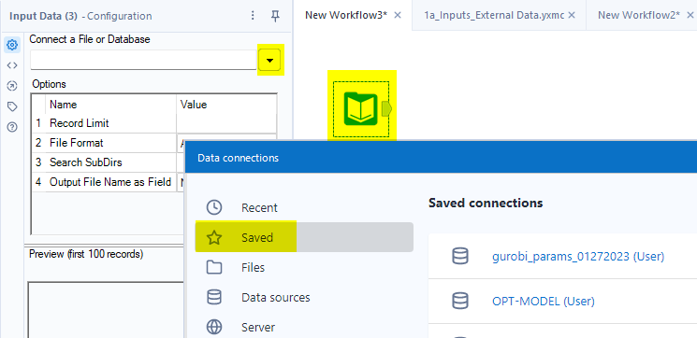
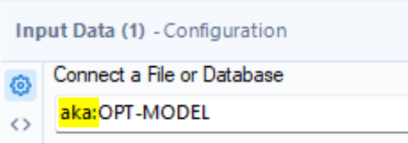
Creating Saved Connections
The Saved Connection can now be use in an input or output tool.
For input or output tool configuration, click the button next to ‘Connect to a File or Database’, then select ‘Saved’ from the Data Connections screen and choose a Saved Connection.
The remaining configuration steps are the same as outlined in the end of the ‘Setting Up a New Cosmic Frog Data Source’ section (slide #12). The final connection in the input/output tool will display as “aka:SavedConnectionName“.

Slide 23
Updating Connections in Batches

Slide 24
Updating Connections in Batches
Once connections are established in an Alteryx workflow file, they can be updated in batches to avoid making multiple edits across all input/output tools.
  This is convenient when needing to point to a new Cosmic Frog model, but can be used for any connection types as well such as Excel files.
  The most common use cases are likely Data Source based Connections and Saved Connections
    Data Source Connection Example:
    Saved Connection Example:

Slide 25
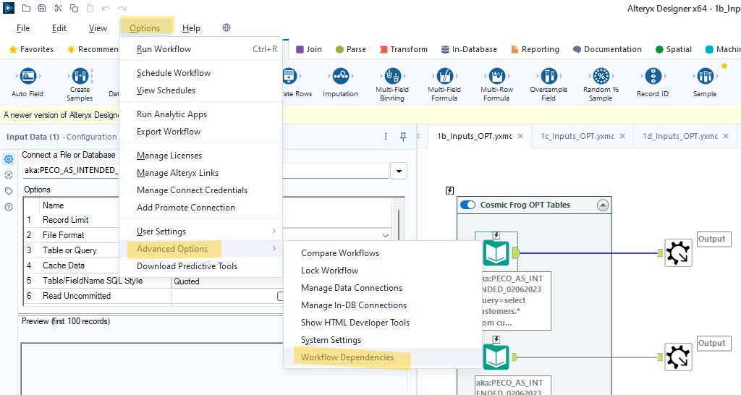
Updating Connections in Batches
On the main menu click “Options”, then click “Advanced Options” and finally “Workflow Dependencies”. This will lead to the window below that displays all connections used in the workflow file.
*If working with a shared workflow that leverages macros (.yxmc files), this initial view could look different and require alternate steps. See end of this section.

Slide 26
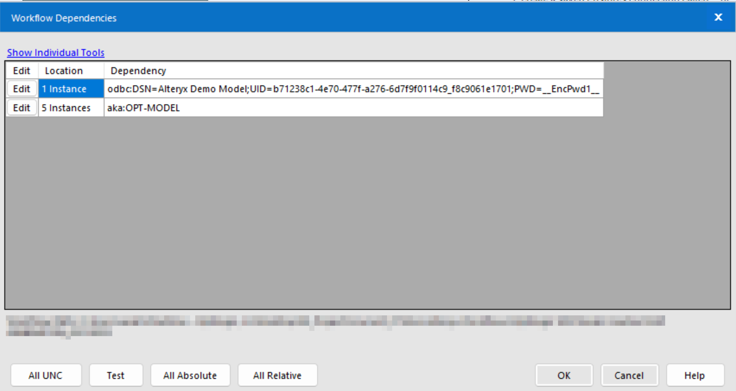
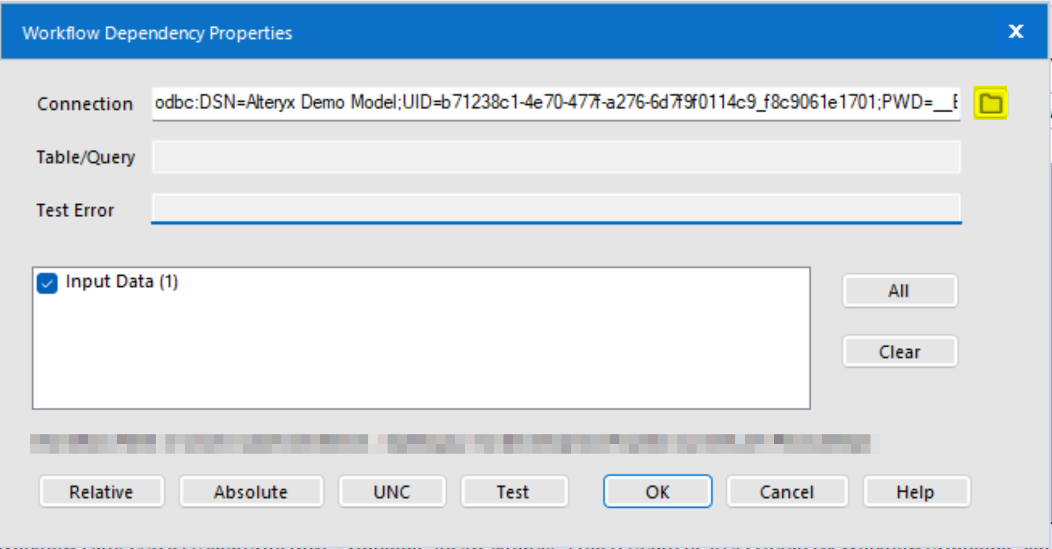
Updating Connections in Batches
Update to New Data Source
Click “Edit” next to a connection. In the new pop-up window, click on the folder icon.

Slide 27
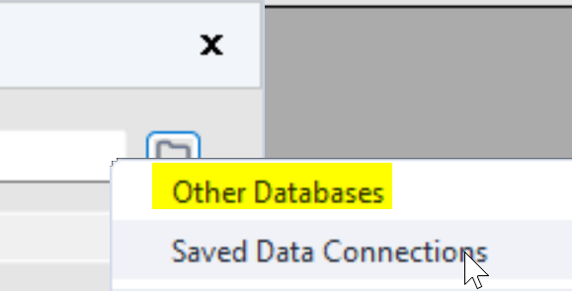
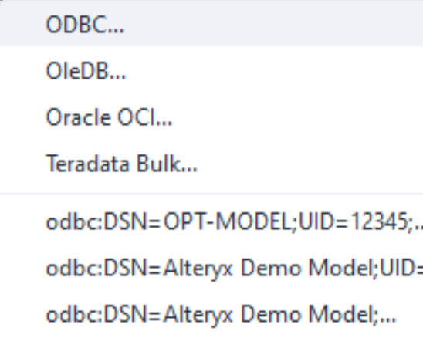
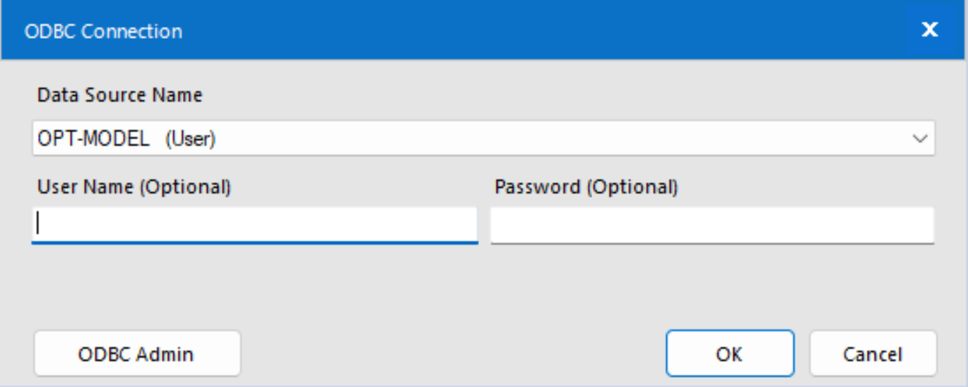
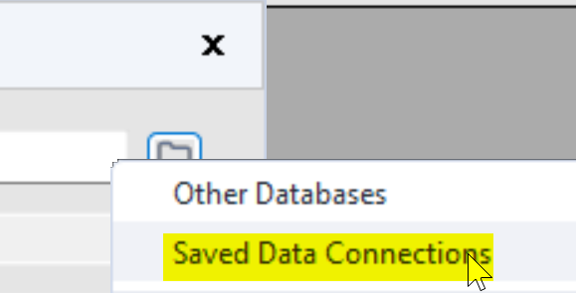
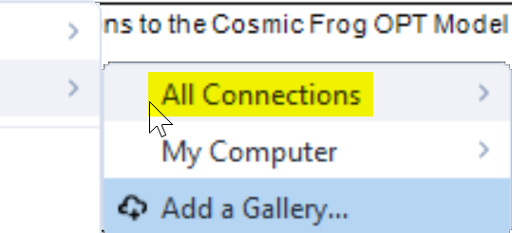
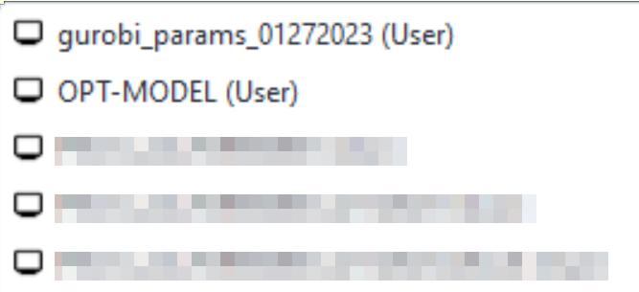
Updating Connections in Batches
If updating to a new Data Source:
  Click ‘Other Databases’. Select ‘ODBC…’ if you do not see your Data Source in the recently used connection list. If ‘ODBC…’ was selected, enter in the additional required connection fields. Click OK.
If updating to a Saved Connection:
  Click ‘Saved Data Connections’, ‘All Connections’, then select a Saved Connection.

Slide 28
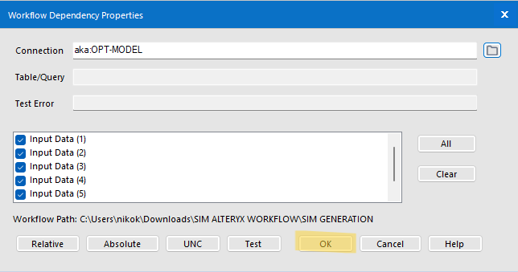
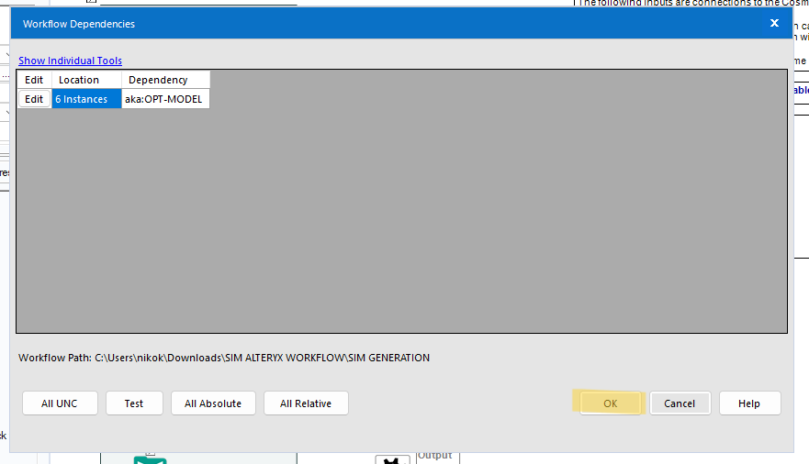
Updating Connections in Batches
Click “OK” to reflect the change in the previous screen.
Finally, click one more time “OK” to update all the connections

Slide 29
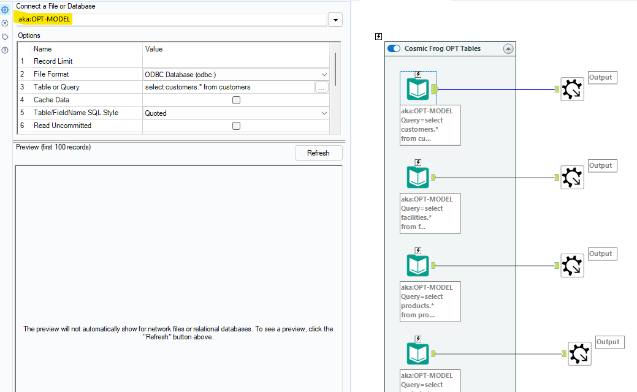
Updating Connections in Batches
The updated connection will be reflected in the “Connect a File or Database” section of Alteryx.

Slide 30
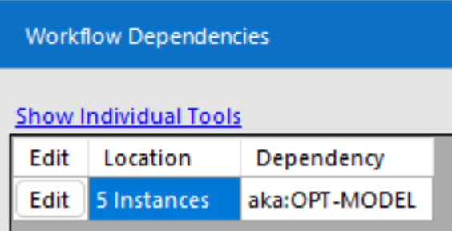
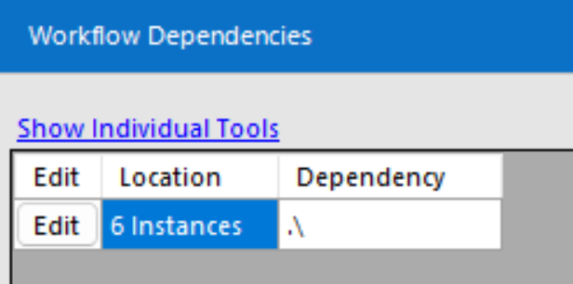
Updating Connections in Batches
If another user has shared an Alteryx workflow with interconnected macro files, the first update of these connections cannot be done in a batch.
If the Workflow Dependencies window displays what should be a Saved Connection or Data Source simply as a relative path, one by one update per input/output tool is required.
  Expected View:
  View when shared by another user:

Slide 31
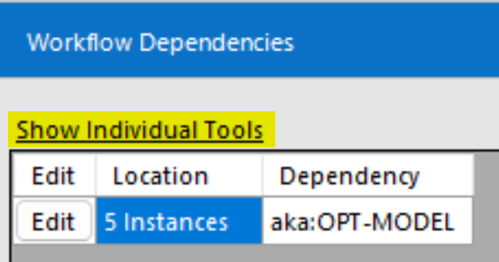
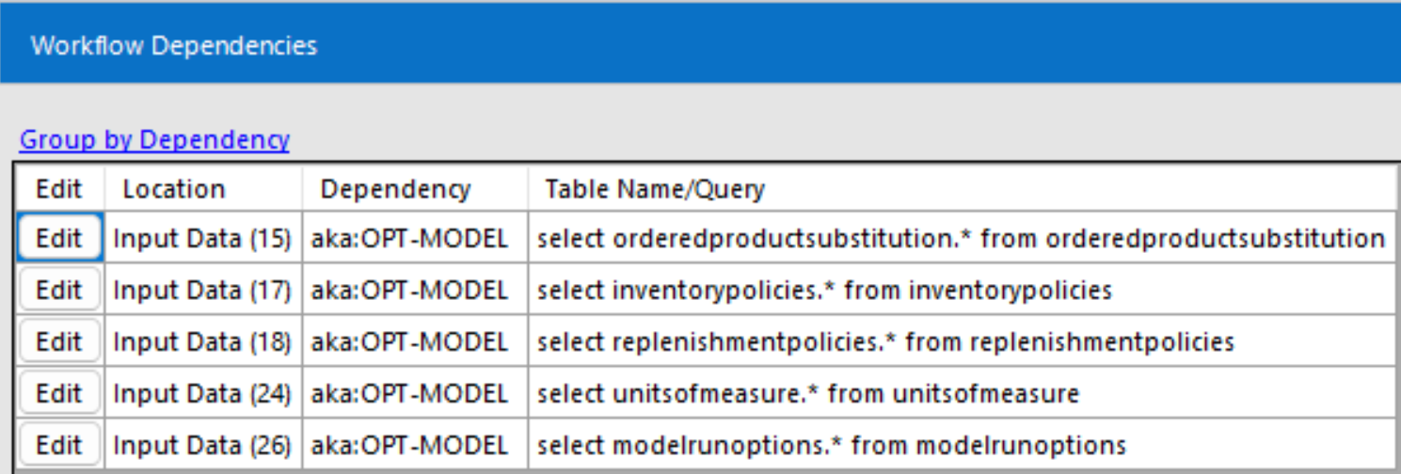
Updating Connections in Batches
To update connection in this situation through the ‘Workflow Dependencies’ menu, you can click ‘Show Individual Tools’.
This will expand the list for each tool in the file. The connections can then be updated one by one.

Slide 32

Updating Connections in Batches
Alternatively, a user can click on each input/output tool needing updating and click the down arrow to navigate to a different connection
  ‘Recent’ is the best place for Data Sources without Saved Connections.
  ‘Saved’ will list all Saved Connections.
A user can also click on each input/output tool needing updating and simply paste the Data Source info or Saved Connection Name into the ‘Connect to a File or Database’ window.

Slide 33
Reuse A Saved Connection Name

Slide 34

Reuse A Saved Connection Name
Reusing Saved Connection names is handy when avoiding updating input or output tool individually, especially when batch update of connections is difficult (see previous section).
If a user shares a workflow with a saved connection, the next user can create a connection with the same name and the workflow will be able to connect to the new user's model without additional configuration.
  If a workflow tool points to a Saved Connections that does not exist in a users Alteryx, this error will appear.
  See the ‘Creating Saved Connections’ section for how to setup a new Saved Connection.

Slide 35

Reuse A Saved Connection Name
If a user would like to updated their workflow to point to a different model, the Saved Connection name can be reused to minimize reconfiguration.
The user needs to first crate a Data Source that points to the new model.
  See ‘Setting Up a New Cosmic Frog Data Source’ section.
Once the new Data Source is set up, delete the old Saved Connection via the Manage Data Connections window.

Slide 36

Reuse A Saved Connection Name
Create a new saved connection with the same name as before
  Remember the connections for pushing data to Cosmic Frog should use a ‘PostGresSQL Bulk connection type. Connections for pulling data should use ODBC.
  You will have to re-enter your database information and credentials while creating the saved connection.
  All tools associated with this Saved Connection should now work.

